Slide 1
Challenges in High-Resolution, High-Volume Earth Science
COLA has carried out multiple high-resolution, high-volume projects, using state-of-the-art coupled general circulation models
Thousands of simulated years, multiple petabytes
Project Minerva
Global, coupled simulations with ECMWF seasonal forecast model
Multiple years, multiple ensemble members, multiple starts within years
Roughly 60 million core hours on NCAR Yellowstone
Project Metis
Follow-on to Project Minerva
Global, coupled simulations with updated ECMWF seasonal forecast model
New dynamical core, different atmosphere and ocean grids
Roughly 60 million core hours on NCAR Cheyenne, successor to Yellowstone
Half-Century Reforecasts
Global coupled 12-month predictions with CESM and CFS starting in 1958
Completely different models from Minerva and Metis
Some runs performed at NCAR, some at TACC

Slide 2
Project Metis: Cheyenne ASD
System | Atmosphere model cycle | Atmosphere spectral truncation | Atmosphere vertical levels | Ocean model | Ocean horizontal res. | Ocean vertical levels
METIS | IFS cy 43r1 | T_{CO}199 (64km) T_{CO}639 (16km) T_{CO}1279 (9km) | 91 levels, top = 1 Pa | NEMO v 3.4.1 | T_{CO}199: 1º T_{CO}639: 0.25º T_{CO}1279: 0.25º | T_{CO}199:42 T_{CO}639: 75 T_{CO}1279: 75
Data location: COLA, on /shared/metis, NCAR on HPSS and /glade2/h2/agmu0001
Data types: 6-hourly tco199 and tco639 data at COLA for 6-month runs
6-hourly data available at NCAR for all runs
T42 versions of data available as well
GRIB, GRIB2, netCDF
1+ PB output
Resolution | Start Dates (1st of month) | Ensembles | Length | Period of Integration
T_{CO}199 (~64 km) | May, Nov | 25 | 6 months | 1981-2016
 | Jun, Jul, Aug, Dec, Jan, Feb | 15 | 2 months | 1986-2015
T_{CO}639 (~32 km) | May, Nov | 25 | 6 months | 1981-2016
 | Jun, Jul, Aug, Dec, Jan, Feb | 15 | 2 months | 1986-2015
T_{Co}1279 (~9km) | May, Nov | 15 | 2 months | 1986-2015

Slide 3
These projects have been highly successful but have also revealed many challenges and inefficiencies at every step of the process…

Slide 4
Initial Set Up Challenges
Obtain source code
Minerva, Metis, CFSv2: Personal communication and collaboration with operational center
CESM: Check out desired version from code archive (Subversion)
Potentially include and automate as streamlining target?
Install and compile
Codes generally include optimal compiler choices and are fairly automated
Obtain initial and boundary condition files
Files may be provided with the release (Minerva, Metis, CFSv2)
May need to be generated offline from an observational product (CESM)
Requires obtaining observational data and processing it to the model grid
Currently performed via multiple, separately developed interpolation scripts
Another potential streamlining target?

Slide 5
Production Challenges
Requires management of large numbers of simultaneous integrations
Significant human resource overhead
Checking for failed runs
Potentially 1000s of simultaneous runs
Managing computing and storage requirements
Can rapidly exhaust both allocated disk space and core hours
Managing program dependencies
Model output frequently requires extensive post-processing to be useful
Regridding, time averaging, vertical interpolation, combining domains
Much more manageable task if it is incorporated into the production runs, but then you need to verify runs have completed before launching post-processing
Currently performed using custom scripts, python-based workflow managers such as Cylc

Slide 6
Analysis Challenges
Output formats are not standardized
GRIB, GRIB2 (sometimes both in the same file!), compressed netcdf
Grids are not standardized
Reduced gaussian, tripolar ocean, spectral coordinates
Need to potentially act on large number of large files
Data files often written in sequence of files containing daily values
Variables separated between upper level fields
Need to operate across variable fields, across files, across models

Slide 7
Analysis Challenges
Data tends to remain at the supercomputing site where it was generated
Vast majority of Metis and Minerva data is still at NCAR
Moving petabytes of data is highly involved, difficult and tedious at best, and generally impractical due to time required for transport and lack of local storage capacity
Most analysis must be done at the remote site
Requires scientists to recreate their analysis process at the remote site
People hate doing this and tend to simply ignore the new data as a result
Analysis frequently requires comparison to additional data
Requires bringing the data to the model as well
Units/grids/formats need to be normalized
Data may be in secondary storage (HPSS) and not readily available
Collaboration between groups compounds all of these issues

Slide 8
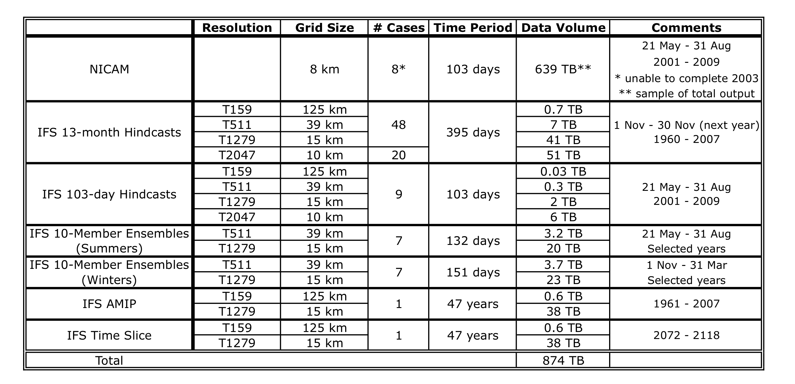
Athena Experiments
Data location: COLA, on /shared/nics
Data types: Primarily monthly means. Some experiments available only at reduced resolution

Slide 9
Project Minerva: Yellowstone ASD
System | Atmosphere model cycle | Atmosphere spectral truncation | Atmosphere vertical levels | Ocean model | Ocean horizontal res. | Ocean vertical levels
MINERVA | IFS cy 38r1 | T_{L}319 (64km) T_{L}639 (32km) T_{L}1279 (16km) | 91 levels, top = 1 Pa | NEMO v 3.0/3.1 | 1 degree | 42 levels
Resolution | Start Dates (1st of month) | Ensembles | Length | Period of Integration
T_{L}319 | May, Nov | 51 | 7 months | 1980-2013
 | Nov | 15 | 24 months | 1980-2013
T_{L}639 | May, Nov | 15 | 7 months | 1980-2013
 | May, Nov | 36 | 5 (4) months | 1980-2013
 | Nov | 15 | 24 months | 1980-2013
T_{L}1279 | May, Nov | 15 | 7 months | 1980-2013
Data location: COLA, on /shared/minerva, NCAR on HPSS and /glade/p/aola0001
Data types: Monthly means at COLA, higher frequency at T42. 6-hourly data available at NCAR

Slide 10
57 years (1958-2014) CFSv2 Reforecast Experiment
Initial Conditions (ICs)
1958-1978
1979-2014
Atmosphere | ERA-40 | CFSR | 4 members (The first 4 days of each month)
Land | NASA GLDAS2
Sea Ice | CFSR (January 1, 1979, April 1, 1979, July 1, 1979, October 1, 1980 )
Ocean | ORA-S4 |  | 5 members*
* Perturbed through ocean data assimilation.
totally 20 ensemble members
Reforecast Duration: 12 months (total model years: 4560)
Location: /shared/bias_correction/hindcast/multi_oics/ORAS4
Output:
Monthly mean (12 months)
Daily (90 days, selected atmosphere and ocean fields)

Slide 11
46 years (1959-2005) CESM (LENS) Reforecast Experiment
Initial Conditions (ICs): Jan 1, Apr 1, Jul 1, Oct 1
Atmosphere | ERA-40 | 2 members (The first 4 days of each month)
Land | CLM4 (forced offline with atmospheric data)
Sea Ice | As per NMME (taken from 7-day run initialized with climatology)
Ocean | ORA-S4 | 5 members*
* Perturbed through ocean data assimilation.
total 10 ensemble members
Reforecast Duration: 12 months (total model years: 1840)
Output:
Monthly mean, daily
Data at NCAR: /glade/p/p93300190

